Slide 1
Transport and Interaction of Blood and LDL
A computational study in near-wall regions of Abdominal Aortic Aneurysms and Stenosed Arteries
Based on research by Satyajit Choudhury, K. Anupindi & B. S. V. Patnaik (2021)

Slide 2
Model Assumptions, COMSOL Parameters & Modules
Assumptions
COMSOL Parameters
Homogeneous, incompressible, Newtonian blood
Vessel wall permeable to LDL (V_{w} ~ 10⁻⁶ cm/s)
Uniform inlet LDL concentration (C = C₀)
Flow is completely laminar throughout
Name
Value
Description
ρ_{b}
1060 kg/m³
Density of blood
μ_{b}
0.004 Pa·s
Dynamic viscosity
Sc
1.31E5
Schmidt number
Vw
4E-8 m/s
Filtration velocity
T
0.83s
Cardiac period
c₀
1 mol/m³
Inlet concentration
COMSOL Modules
Laminar Flow (spf) — fluid flow solver
Transport of Diluted Species (tds) — LDL mass transport

Slide 3
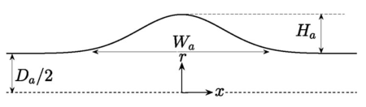
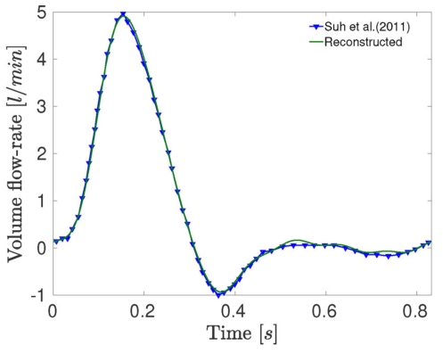

Geometry – AAA (Abdominal Aortic Artery)
Geometry
Inlet Flow Rate Profile
Name
Value
Description
Da
1.7 cm
Undilated artery diameter
Wa
0.5 * Da
Width of pathological portion of AAA
Ha
0.5 * Da
Dilation of aneursym
Re
264
X_min
-10 * Da
X_max
20 * Da
$$r\left(x\right)= \frac{D_{a}}{2}+ H_{a}\exp{(\frac{−x^{2}}{2{Wa}^{2}})}$$

Slide 4
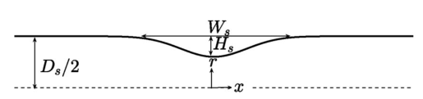
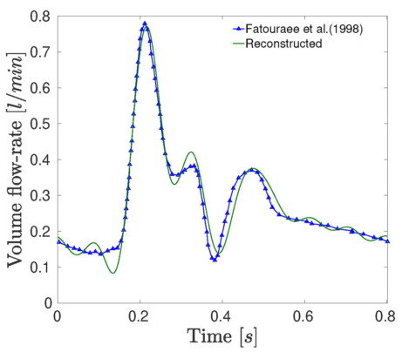

Geometry – Stenosed Artery
Geometry
Inlet Flow Rate Profile
Name
Value
Description
Ds
0.7 cm
Unrestricted artery diameter
Ws
0.5 * Ds
Width of pathological portion of stenosed artery
Hs
0.2 * Ds
Constriction of stenosis
Re
250
X_min
-10 * Ds
X_max
20 * Ds
$$r\left(x\right)= \frac{D_{s}}{2}− H_{s}\exp{(\frac{−x^{2}}{2{Ws}^{2}})}$$

Slide 5

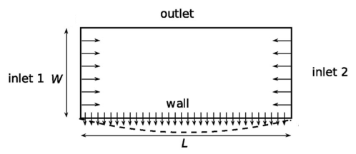
Simplified Flow Domain for Flow Separation
Geometry
Grid Independent Mesh
Name
Value
Description
W/L
0.4
Aspect ratio
Baseline Selection: 340 x 105
W
0.002 m
Width
V_in_sep(t) = 0.0036 + 0.004sin(7.554(t-0.148))

Slide 6




Governing Equations
Fluid Flow Equations
(Laminar Flow)
Navier-Stokes Equation
$$ρ\left(u∙∇\right)u= ∇∙\left[−pI+K\right]+F$$
Continuity Equation
$$ρ∇∙u=0$$
p = static pressure | I = identity tensor | K = viscous stress tensor | F = body force vector field
Convection-Diffusion
Equation
Mass Transport Equations
(Transport of Diluted Species)
$$∇∙J_{i}+u∙∇c_{i}= R_{i}$$
Fick’s Diffusion Law
$$J_{i}= {−D}_{i}∇c_{i}$$
J = diffusive flux | R = reaction rate term

Slide 7




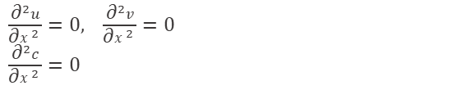
Boundary Conditions
Location
Condition
Equation
Vessel wall
(no-slip)
No-slip axial velocity
Radial velocity = Vw / ū₀
$u\left(x,1,t\right)=0$
$v\left(x,1,t\right)= \frac{V_{w}}{\overline{u0}}$
Inlet
(x = 0)
Womersley pulsatile velocity
Uniform LDL concentration
$u\left(0,y,t\right)= u_{wm}, v\left(0,y,t\right)=0$
$c\left(0,y,t\right)=1$
Axis of
symmetry
Streamline; zero vorticity
Zero radial conc. gradient
$v\left(x,0,t\right)=0$
$\frac{\text{∂}u}{\text{∂}y}=0, \frac{\text{∂}c}{\text{∂}y}=$0
Outlet
(x = 10R₀)
Extrapolation condition
(no upstream reflection)
$\frac{{\text{∂}}^{2}u}{{\text{∂}x}^{2} }=0,$ $\frac{{\text{∂}}^{2}v}{{\text{∂}x}^{2} }=0$
$\frac{{\text{∂}}^{2}c}{{\text{∂}x}^{2} }=0$
Wall
(LDL conc.)
Convective flux = diffusive flux
at impervious vessel wall
$$V_{w}C_{w}= \frac{2{\overline{u0}C}_{0}}{Re Sc} (\frac{\text{∂}c}{\text{∂}y})_{w}$$

Slide 8
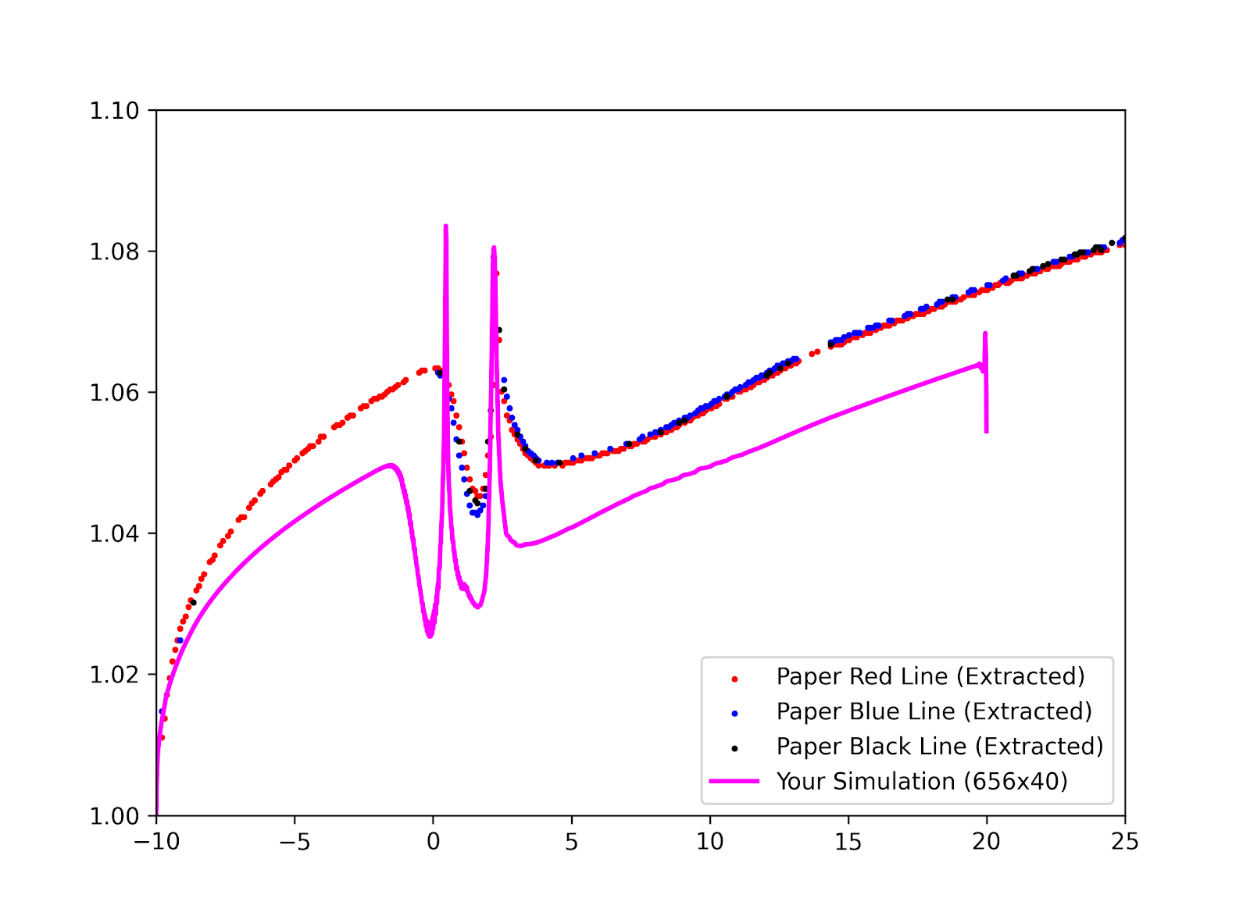
Comparison (Stenosed Artery)
Flow Separation Domain
Notes:
Two Stagnation Zones: The double peak is a documented physical phenomenon in stenosed vessels. The primary sharp peak forms at the flow separation point (right at the throat exit), while the secondary kink forms further downstream at the flow reattachment point (where the jet hits the wall again).
Zero Convective Clearance: At both the separation and reattachment lines, the fluid velocity tangential to the wall drops exactly to zero. Because the fluid isn't moving horizontally to sweep molecules away, solutes (LDL) pile up at these two distinct axial locations.

Slide 9
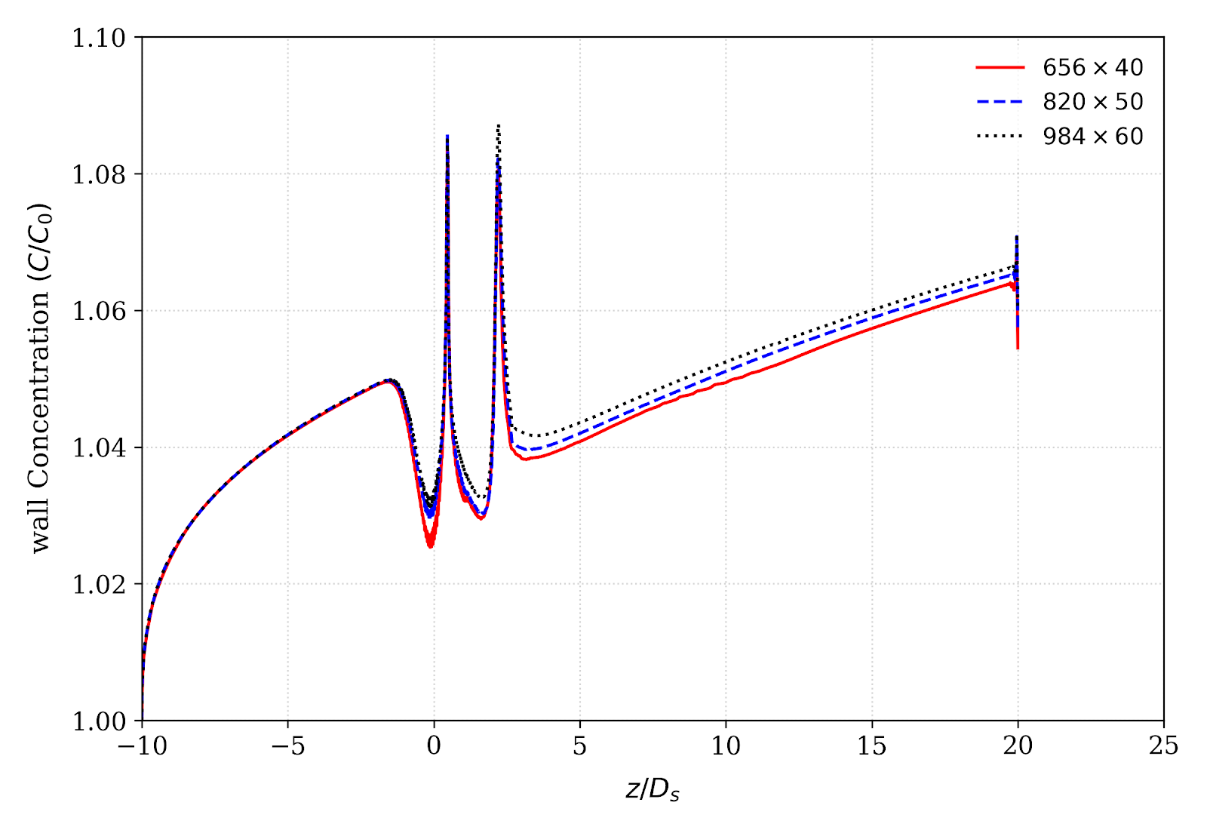
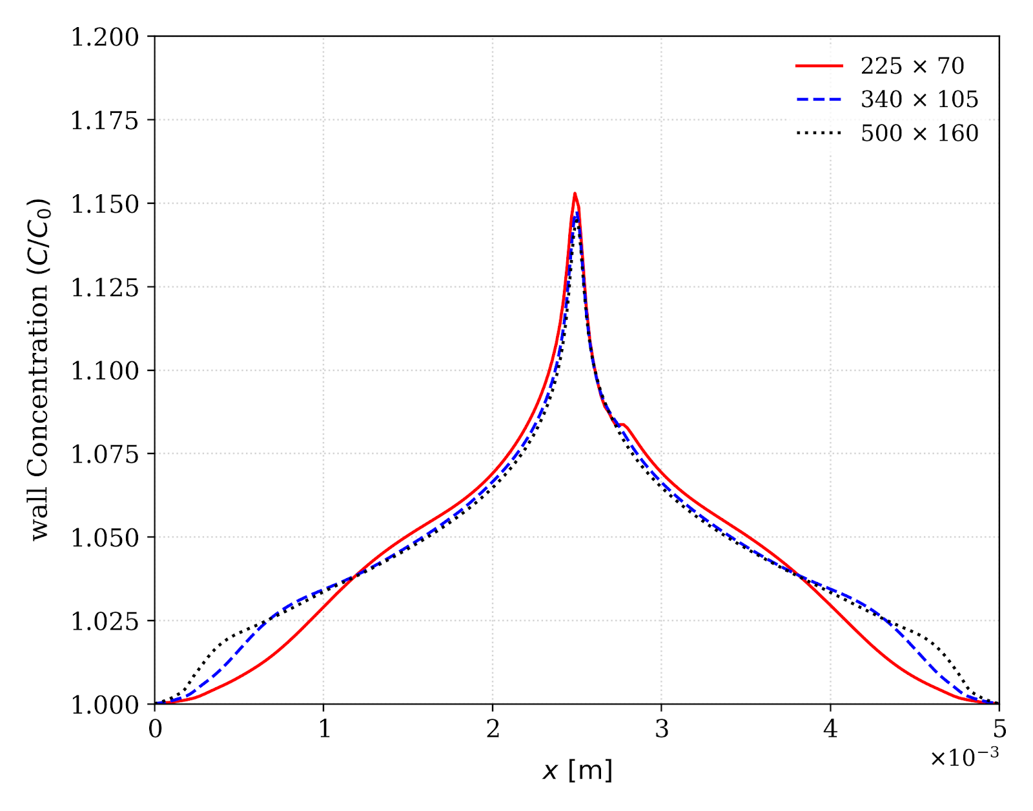
Grid Independent Study
Stenosed Artery
Flow Separation Domain
Fig. 4a — Grid independence test for stenosed artery
Fig. 4b — Grid independence test for flow separation domain

